Slide 1
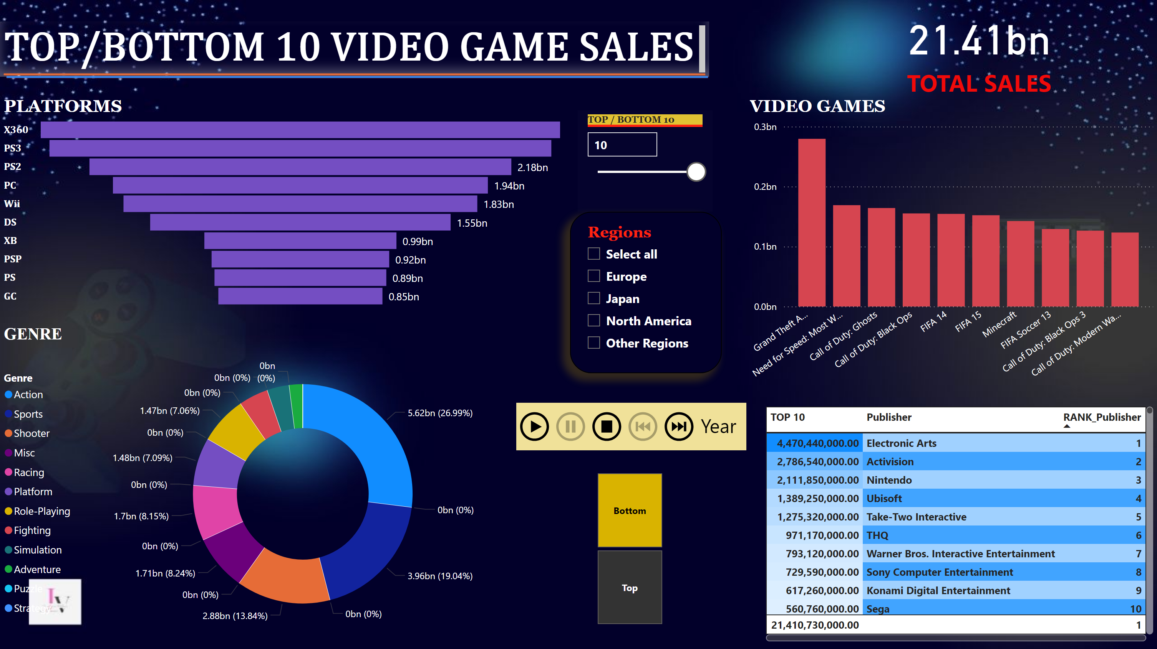
Page 1
Notes:
GENRE
No alt text provided
PLATFORMS
No alt text provided
VIDEO GAMES
No alt text provided
slicer
No alt text provided
slicer
No alt text provided
tableEx
No alt text provided
slicer
No alt text provided
card
No alt text provided
textbox
No alt text provided
shape
No alt text provided
PBI_CV_16948668_E17D_454B_8664_2F2C470EA8C1
No alt text provided

